Slide 1
Chapter 3

Slide 2
3.1 | Design quality, Classification of Design Activities, Design Concepts: Modularity and Layering, Introduction to Pattern-Based Software Design,
3.2 | Software Architecture, Data Design, Object-Oriented versus Function-Oriented Design, Design of Software Objects, Methods, Cohesion and Coupling between Objects,
3.4 | User Interface Design: Rules, User Interface Analysis and Steps in Interface Design, Design Evaluation
3.5 | Software Reuse, Component-Based Software Engineering

Slide 3
Design Quality
Software design is an iterative process through which requirements are translated into a “blueprint” for constructing the software.
Developers identify and prioritize the qualities of the system that they should optimize.

Slide 4
Design and Quality
the design must implement all of the explicit requirements contained in the analysis model, and it must accommodate all of the implicit requirements desired by the customer.
Explicit Requirements: The Things You Wrote Down
Implicit Requirements: The Things Your Customers Will Expect
Latent Requirements: Things That Will Delight Your Customers
the design must be a readable, understandable guide for those who generate code and for those who test and subsequently support the software.
the design should provide a complete picture of the software, addressing the data, functional, and behavioral domains from an implementation perspective.

Slide 5
Quality Guidelines
A design should exhibit an architecture that:
Created using standard architectural patterns.
composed of components that exhibit good design characteristics.
can be implemented in an evolutionary fashion
A design should be modular: logically partitioned into elements or subsystems

Slide 6
Quality Guidelines
A design should contain distinct representations of data, architecture, interfaces, and components.
A design should lead to data structures that are appropriate for the classes to be implemented and are drawn from recognizable data patterns.
A design should lead to components that exhibit independent functional characteristics.

Slide 7
Quality Guidelines
A design should lead to interfaces that reduce the complexity of connections between components and with the external environment.
A design should be derived using a repeatable method that is driven by information obtained during software requirements analysis.
A design should be represented using a notation that effectively communicates its meaning.

Slide 8
Design Activities
The implementation phase of software development is the process of converting a system specification into an executable system through the design of system.

Slide 9
Design Activities
The design process activities are the followings:
Architectural design
The architectural design for software is the equivalent to the floor plan(overview) of a house.
Architectural design elements give us an overall view of the software.

Slide 10
Design Activities
Architectural model is derived from three sources:
Information about the application domain for the software to be built
(2) specific requirements
(3) the availability of architectural Styles and patterns

Slide 11
Design Activities
2. Interface Design
analogous to a set of detailed drawings.
Specifications of software
The interface design elements for software depict information flows into and out of the system and how it is communicated among the components defined as part of the architecture.

Slide 12
Design Activities
3 important elements of interface design:
(1) the user interface (UI)
(2) external interfaces
(3) internal interfaces
3. Component-Level Design
The component-level design for software is the equivalent to a set of detailed drawings (and specifications) for each room in a house.

Slide 13
Design Activities
The component-level design for software fully describes the internal detail of each software component.
component-level design defines data structures for all local data objects and algorithmic detail.
Within the context of object-oriented software engineering, a component is represented in UML diagrammatic form.

Slide 14
Design Activities
4. Data structure design.
The data structures used in the system implementation are designed in detail and specified.
5. Algorithm design.
In this activity the algorithms used to provide services are designed in detail and specified.

Slide 15
Design Activities
6. Deployment-Level Design
indicate how software functionality and subsystems will be allocated within the physical computing environment that will support the software.
For example, the elements of the SafeHome product configured to operate within three primary computing environments
home-based PC
SafeHome control panel
server housed at CPI Corp. (providing Internet-based access to the system).

Slide 16
Design Principles
The design process is a sequence of steps that enable the designer to describe all aspects of the software to be built.
The design process should not suffer from “tunnel vision.”- A good designer should consider alternative approaches.
2. The design should be traceable to the analysis model.- means for tracking how requirements have been satisfied by the design model.

Slide 17
Design Principles
3. The design should not reinvent the wheel. - Design time should be invested in representing truly new ideas and integrating those patterns that already exist.
4. The design should “minimize the intellectual distance” between the software and the problem as it exists in the real world. - structure of the software design should be replica of structure of the problem domain.

Slide 18
Design Principles
5. The design should exhibit uniformity and integration.
format should be defined for a design team before design work begins.
design is integrated if care is taken in defining interfaces between design components.
6. The design should be structured to accommodate change.

Slide 19
Design Principles
7. The design should be structured to degrade gently, even when aberrant data, events, or operating conditions are encountered.
Well designed software should never “bomb.”
It should be designed to accommodate unusual circumstances, and if it must terminate processing, do so in a graceful manner.

Slide 20
Design Principles
8. Design is not coding, coding is not design.
the level of abstraction of the design model is higher than source code.
only design decisions made at the coding level address the small implementation details.
9. The design should be assessed for quality as it is being created, not after the fact.
10. The design should be reviewed to minimize conceptual (semantic) errors.

Slide 21
Design Concepts
Software Design concepts are fundamental concepts which provides the software designer with a foundation from which more sophisticated design methods can be applied for software design process

Slide 22
Design Concepts
Abstraction
modular solution to any problem , many levels of abstraction can be posed.
At the highest level of abstraction, a solution is stated in broad terms using the language of the problem environment.
lower levels of abstraction, a more procedural orientation is taken.
Each step in the software process is a refinement in the level of abstraction of the software solution.

Slide 23
Design Concepts
A procedural abstraction is a named sequence of instructions that has a specific and limited function. (algorithm)
Example: word DOOR implies a long sequence of procedural steps
A data abstraction is a named collection of data that describes a data object
Example: word DOOR would encompass a set of attributes that describe the door

Slide 24
Design Concepts
control abstraction implies a program control mechanism for coordinating activities.
2. Refinement
Refinement is process of elaboration
top-down design strategy
A program is developed by successively refining levels of procedural detail.

Slide 25
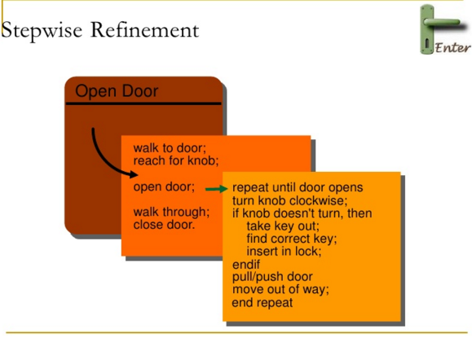
Design Concepts

Slide 26
Design Concepts
Refinement causes the designer to elaborate on the original statement, providing more and more detail as each successive refinement (elaboration) occurs.
Abstraction and refinement are complementary concepts.

Slide 27
Design Concepts
3. Modularity
software is divided into separately named and addressable components, often called modules, that are integrated to satisfy problem requirements.
modularity is the single attribute of software that allows a program to be intellectually manageable.

Slide 28
Modular Design

Slide 29
Design Concepts
"divide and conquer" conclusion—it's easier to solve a complex problem when you break it into manageable pieces - an argument for modularity.

Slide 30
Modularity: Trade-offs
What is the "right" number of modules
for a specific software design?
module development cost
cost of
software
module
integration
cost
optimal number
number of modules
of modules

Slide 31
Design Concepts
five criteria to define an effective modular system:
Modular decomposability – systematic mechanism for decomposing the problem into sub problems.
2. Modular composability – reusing existing system into new system yield modular solution and not reinvent wheel.
3. Modular understandability - understood as standalone unit , it will be easier to build and easier to change.

Slide 32
Design Concepts
4. Modular continuity - small changes to the system requirements - changes to individual modules rather system – change induced side effects minimized.
5. Modular protection - aberrant condition - error-induced side effects minimized.

Slide 33
Design Concepts
4. Software Architecture
architecture—the overall structure of the software.
architecture is the hierarchical structure of program components (modules),the manner in which these components interact and the structure of data that are used by the components.

Slide 34
Design Concepts
Well designed architecture servers as framework for detailed design activities which can also help in reuse of design level concepts.
Properties of an architectural design:
Structural properties: This aspect of the architectural design representation defines the components of a system and their interaction with one another.
Extra-functional properties: like performance, capacity, reliability, security, adaptability, and other system characteristics.

Slide 35
Design Concepts
3. Families of related systems: The architectural design should draw upon repeatable patterns that are commonly encountered in the design of families of similar systems.

Slide 36
Design Concepts
Different architectural models
Structural models represent architecture as an organized collection of program components.
2. Framework models identify repeatable architectural design frameworks (patterns)
3. Dynamic models address the behavioral aspects of the program architecture, indicating changes in configuration of system.

Slide 37
Design Concepts
4. Process models focus on the design of the business or technical process that the system must accommodate.
5. Functional models can be used to represent the functional hierarchy of a system.

Slide 38
Design Concepts
5. Patterns
a design pattern describes a design structure that solves a particular design problem within a specific context.
The intent of each design pattern is to provide a description that enables a designer to determine:
whether the pattern is applicable to the current work
(2) whether the pattern can be reused

Slide 39
Design Concepts
(3) whether the pattern can serve as a guide for developing a similar, but functionally or structurally different pattern.

Slide 40
Design Concepts
6. Information Hiding
The intent of information hiding is to hide the details of data structures and procedural processing behind a module interface.
Knowledge of the details need not be known by users
independent modules that communicate with one another only that information necessary to achieve software function

Slide 41
Design Concepts
information hiding provides the greatest benefits when modifications are required.
Because most data and procedural detail are hidden from other parts of the software errors less likely to propagate.

Slide 42
Design Concepts
7. Functional Independence
Software should be designed such that each module addresses a specific subset of requirements and has a simple interface with other program structure.
Software with effective modularity, that is, independent modules, is easier to develop.

Slide 43
Design Concepts
Independent modules
easier to maintain (and test)
effects caused by design or code modification limited
error propagation is reduced
reusable modules are possible.
functional independence is a key to good design, and design is the key to software quality.

Slide 44
Design Concepts
Independence is assessed using two qualitative criteria:

Slide 45
Design Concepts
Cohesion
A cohesive module performs a single task, requiring little interaction with other components in other parts of a program.
High degree of cohesion is advisable but it is also necessary and advisable for components to perform multiple functions.

Slide 46
Design Concepts
2. Coupling
Coupling is an indication of interconnection among modules in a software structure.
Coupling depends on the interface complexity between modules – entry point and type of data that passes through interface.
In software design, one should strive for the lowest possible coupling.

Slide 47
Design Concepts
Simple connectivity among modules results in software that is easier to understand and less prone to a “ripple effect”

Slide 48
Design Concepts
8. Refactoring
Refactoring is the process of changing a software system in such a way that it does not alter the external behavior of the code [design] yet improves its internal structure.
When software is refactored:
the existing design is examined for redundancy
unused design elements
inefficient or unnecessary algorithms
poorly constructed or inappropriate data structures,
any other design failure that can be corrected to yield a better design.

Slide 49
The Design Model
The design model can be viewed in two different dimensions:
Each element of analysis model is transformed into design model and refined iteratively.
The process dimension as design tasks are executed as part of software process.
The abstraction dimension represents the level of detail in each element

Slide 50
The Design Model

Slide 51
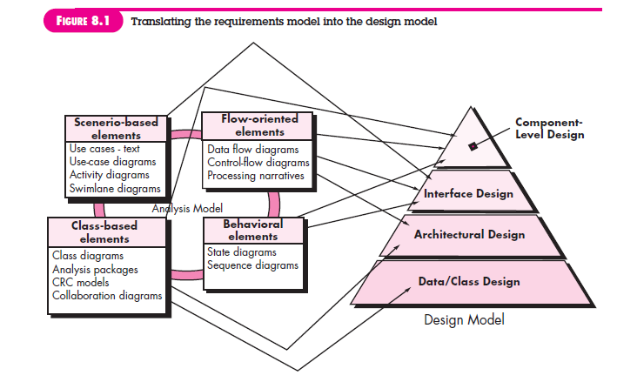

Slide 52
The Design Model
Elements of Design Model
Data Design Elements
data structures
database architecture
Architectural Design Elements
The architectural design for software is the equivalent to the floor plan of a house.
Three sources for development of architecture model
information about the application domain for the software to be built.
(2) specific requirements model elements (data flow diagrams , collaboration etc.)

Slide 53
The Design Model
(3) architectural styles and patterns
Interface Design Elements
The interface design for software is analogous to a set of detailed drawings
There are three important elements of interface design:
the user interface (UI)
(2) external interfaces to other systems, devices, networks, or other producers or consumers of information
(3) internal interfaces between various design components.

Slide 54
The Design Model
Interface design elements allow external/ internal communication and collaboration among various components.
Component-Level Design Elements
The component-level design for software is the equivalent to a set of detailed drawings (and specifications) E.g. Each room of house.
Relationship between the components.
Deployment-Level Design Elements
Deployment-level design elements indicate how software functionality and subsystems will be allocated within the software environment.

Slide 55
Pattern-based Software Design
The best designers in any field have an uncanny ability to see patterns that characterize a problem and corresponding patterns that can be combined to create a solution.
A description of a design pattern may also consider a set of design forces.
Design forces describe non-functional requirements (e.g., ease of maintainability, portability) associated with the software for which the pattern is to be applied.

Slide 56
Pattern-based Software Design
The pattern characteristics (classes, responsibilities, and collaborations) indicate the attributes of the design that may be adjusted to enable the pattern to accommodate a variety of problems (problem solving).
Throughout the design process, one should look for every opportunity to apply existing design patterns rather than creating new ones.

Slide 57
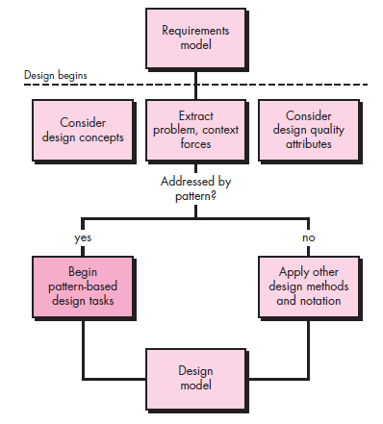
Pattern-based Software Design
1. Pattern-Based Design in Context
Use methods and modeling tools
available for architectural,
component level,
and interface design.

Slide 58
Pattern-based Software Design
2. Thinking in Patterns
“new way of thinking” when one uses patterns as part of the design activity.
Good design begins by considering context—the big picture.

Slide 59
Pattern-based Software Design
approach that enables a designer to think in patterns:
Context of software build and requirements to be understood.
extract the patterns that are present at level of abstraction.
Begin design with “big picture” patterns that establish a context or skeleton for further design work.

Slide 60
Pattern-based Software Design
4. “Work inward from the context” lower levels of abstraction that contribute to the design solution.
5. Repeat steps 1 to 4 until the complete design is fleshed out.
6. Refine the design by adapting each pattern to the specifics of the software

Slide 61
Example of Thinking in Pattern
SafeHomeAssured.com WebApp.
How to provide information about SafeHome products and services?
How to sell SafeHome products and services to customers?
How to establish Internet-based monitoring and control of an installed security system?

Slide 62
Pattern-based Software Design
3. Design Tasks
The following design tasks are applied when a pattern-based design philosophy is used:
Examine the requirements model and develop a problem hierarchy.
Determine if a reliable pattern language has been developed for the problem domain.

Slide 63
Pattern-based Software Design
3. Beginning with a broad problem, determine whether one or more architectural patterns is available for it.
4. Using the collaborations provided for the architectural pattern , examine subsystem or component-level problems and search for appropriate patterns to address them.
Repeat steps until all broad problems have been addressed

Slide 64
Pattern-based Software Design
5. user interface design problems have been -search the many user interface design pattern repositories for appropriate patterns.
6. Compare various pattern against the existing ones for better designing.
7. Be certain to refine the design as it is derived from patterns using design quality criteria as a guide.

Slide 65
Pattern-based Software Design
4. Building a Pattern-Organizing Table
As pattern based design proceeds organizing and categorizing problem may occur.
Solution: A pattern-organizing table can be implemented as a spreadsheet model

Slide 66
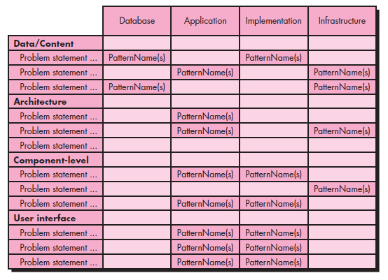
Pattern-based Software Design
Pattern Organizing Table

Slide 67
Pattern-based Software Design
5. Common Design Mistakes
A number of common mistakes occur when pattern-based design is used.
not enough time has been spent to understand the underlying problem.
Wrong pattern selected.
Quality standards ignored.

Slide 68
Software Architecture
Why Architecture?
The architecture is not the operational software. Rather, it is a representation that enables a software engineer to:
(1) analyze the effectiveness of the design in meeting its stated requirements,
(2) consider architectural alternatives at a stage when making design changes is still relatively easy, and
(3) reduce the risks associated with the construction of the software.

Slide 69
Software Architecture
Why is Architecture Important?
Representations of software architecture are an enabler for communication between all parties (stakeholders) interested in the development of a computer-based system.
The architecture highlights early design decisions that will have a profound impact on all software engineering work that follows and, as important, on the ultimate success of the system as an operational entity.
Architecture “constitutes a relatively small, intellectually graspable model of how the system is structured and how its components work together”.

Slide 70
Architectural Styles
Each style describes a system category that encompasses:
a set of components (e.g., a database, computational modules) that perform a function required by a system
(2) a set of connectors that enable “communication, coordination and cooperation” among components
(3) constraints that define how components can be integrated to form the system
(4) semantic models that enable a designer to understand the overall properties of a system by analyzing the known properties of its constituent parts.

Slide 71
Architectural Styles
Data-centered architectures.
A data store (e.g., a file or database) resides at the center of this architecture and is accessed frequently by other components.
Client software accesses a central repository.
Data-centered architectures promote integrability.
New client components can be added easily.
Client components independently execute processes.

Slide 72
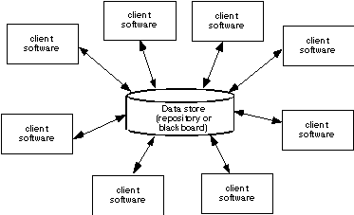
Data-Centered Architecture

Slide 73
Architectural Styles
Data-flow architectures
This architecture is applied when input data are to be transformed through a series of computational or manipulative components into output data.
Pipe and filter pattern.
Each filter works independently.
If the data flow degenerates into a single line of transforms, it is termed batch sequential.

Slide 74
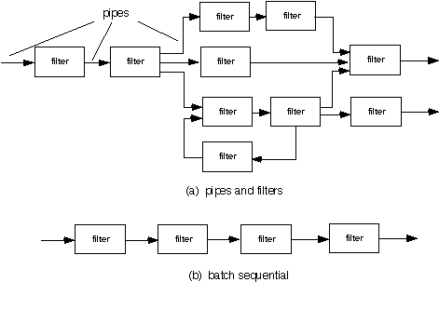
Data Flow Architecture

Slide 75
Architectural Styles
Call and return architectures.
This architectural style enables you to achieve a program structure that is relatively easy to modify and scale.
Sub styles of call and return architecture:
Main program/subprogram architectures: main program invokes a number of program components that in turn may invoke still other components.
Remote procedure call architectures: The components of a main program/subprogram architecture are distributed across multiple computers on a network.

Slide 76
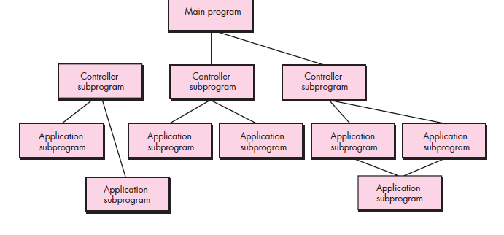
Call and return architectures.

Slide 77
Architectural Styles
Layered architectures.
Layered architecture focuses on the grouping of related functionality within an application into distinct layers that are stacked vertically on top of each other.

Slide 78
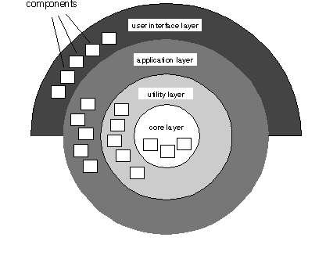
Layered Architecture

Slide 79
Architectural Patterns Issues
A software architecture may have a number of
architectural patterns that address issues such as concurrency, persistence, and distribution.
Concurrency—applications must handle multiple tasks in a manner that simulates parallelism.
Example 1: Operating System Process Management pattern that provides built-in OS features that allow components to execute concurrently.
Example 2: Task Scheduler pattern invokes the next concurrent object

Slide 80
Architectural Patterns
(2) Distribution - The distribution problem addresses the manner in which systems or components within systems communicate with one another in a distributed environment.
Example 1: Broker pattern: broker acts as a middle man to constitute communication.

Slide 81
Architectural Patterns
(3) Persistence - Data persists if it survives past the execution of the process that created it.
Persistent data are stored in a database or file and modified later.
Example 1: Database management system pattern which stores and retrieves data.

Slide 82
Architectural Design
The software must be placed into context
the design should define the external entities (other systems, devices, people) that the software interacts with and the nature of the interaction
A set of architectural archetypes should be identified
An archetype is an abstraction (similar to a class) that represents one element of system behavior.
The designer specifies the structure of the system by defining and refining software components that implement each archetype

Slide 83
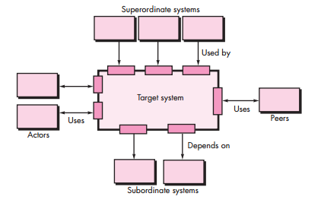
Architectural Context Diagram - model the manner in which software interacts with entities external to its boundaries.

Slide 84
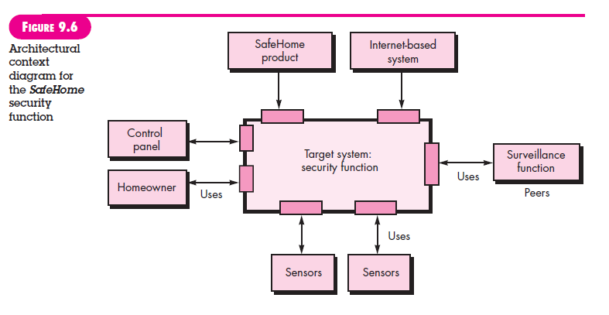

Slide 85
Archetypes - An archetype is a class or pattern that represents a core abstraction that is critical to the design of an architecture for the target system.

Slide 86
Component Structure

Slide 87
Refined Component Structure - A well-designed habitat allows for the successful evolution of all the components needed in a software system.

Slide 88
Cohesion
Cohesion implies that a component or class encapsulates only attributes and operations that are closely related to one another and to the class or component itself.
Different types of cohesion
Functional - Based on operations , this level of cohesion occurs when a component performs a targeted computation and then returns a result.

Slide 89
Cohesion
(2) Layer - Exhibited by packages, components, and classes, this type of cohesion occurs when a higher layer accesses the services of a lower layer, but lower layers do not access higher layers.
(3) Communicational. All operations that access the same data are defined within one class. Focus is only on data in question.

Slide 90
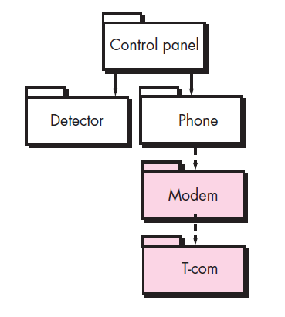
Layered Cohesion

Slide 91
Coupling
Coupling is a qualitative measure of the degree to which classes are connected to one another.
Different types of coupling
(1) Content coupling Occurs when one component secretly modifies data that is internal to another component
(2) Common coupling Occurs when a number of components all make use of a global variable. Common coupling can lead to error propagation.

Slide 92
Coupling
(3) Control coupling – Occurs when one operation controls flow of another operation and control signals are sent. Changes done to an operation are to be monitored for errors.
(4) Stamp coupling – Occurs when systems operation are in nested state , modifying the system becomes complex.
Similar to common coupling but here global data is accessible to selected routines.

Slide 93
Coupling
(5) Data coupling - Occurs when operations pass long strings of data arguments.
B/W of communication increases complexity increases maintenance becomes difficult.
(6) Routine call coupling - Occurs when one operation invokes another
(7) Type use coupling. Occurs when component A uses a data type defined in component B.
If the type definition changes, every component that uses the definition must also change.

Slide 94
Coupling
(8) Inclusion or import coupling. Occurs when component A imports or includes a package or the content of component B.
(9) External coupling - Occurs when a component communicates or collaborates with infrastructure components (e.g., operating system functions,
database capability, telecommunication functions).
This type of coupling is necessary but it should also be limited.

Slide 95
User Interface Design Rules
Place the user in control.
A system or user interface should be designed keeping user in mind.
Interface designed should be easy to use and build.
number of design principles that allow the user to maintain control:
Define interaction modes in a way that does not force a user into unnecessary or undesired actions.
Example: Spell Checking mode

Slide 96
User Interface Design Rules
(2) Provide for flexible interaction. Because different users have different interaction preferences, choices should be provided.
Example: software might allow a user to interact via keyboard commands, mouse movement, a digitizer pen etc.
(3) Allow user interaction to be interruptible and undoable.
(4) Hide technical internals from the casual user.

Slide 97
User Interface Design Rules
(5) Design for direct interaction with objects that appear on the screen.
Example: Zoom option
2. Reduce the User’s Memory Load
The more a user has to remember, the more error-prone the interaction with the system will be.
well-designed user interface does not tax the user’s memory

Slide 98
User Interface Design Rules
defines design principles that enable an interface to reduce the user’s memory load:
Reduce demand on short-term memory – complex tasks demand on short term memory is high - interface designed to reduce dependency.
Establish meaningful defaults - “reset” option should be available for enabling original default values.

Slide 99
User Interface Design Rules
(3) Define shortcuts that are intuitive (easy to use).
Ctrl S , alt P..
(4) The visual layout of the interface should be based on a real-world metaphor.
(5) Disclose information in a progressive fashion - The interface should be organized hierarchically.
An example, word-processing applications

Slide 100
User Interface Design Rules
3. Make the Interface Consistent
“Things that look different should act different. Things that look the same should act the same.”
Allow the user to put the current task into a meaningful context.
Complex layers to be implemented with clear indication to the user about the context of the work at hand.

Slide 101
User Interface Design Rules
(2) Maintain consistency across a family of applications.
A set of applications (or products) should all implement the same design rules - consistency is maintained for all interaction.
(3) If past interactive models have created user expectations, do not make changes unless there is a compelling reason to do so.

Slide 102
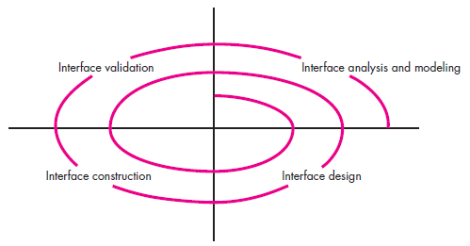
The user interface design process
The analysis and design process for user interfaces is iterative and can be represented using a spiral model.

Slide 103
The user interface design process
(1) Interface analysis – focuses on the profile of the users who will interact with the system. Different user categories are defined.
Once general requirements have been defined, a more detailed task analysis is conducted.
(2) Interface design – is to define a set of interface objects and actions that enable a user to perform all defined tasks to meet goals defined.

Slide 104
The user interface design process
(3) Interface construction - normally begins with the creation of a prototype that enables usage scenarios to be evaluated.
(4) Interface validation - focuses on
the ability of the interface to implement every user task correctly, accommodate all task variations, and to achieve all general user requirements;
the degree to which the interface is easy to use and easy to learn
the users’ acceptance of the interface as a useful tool in their work

Slide 105
Interface Analysis
understand the problem before you attempt to design a solution.
the people (end users) who will interact with the system through the interface.
(2) the tasks that end users must perform to do their work,
(3) the content that is presented as part of the interface
(4) the environment in which these tasks will be conducted

Slide 106
Interface Analysis Steps
User Analysis
User Interviews.
Sales input - Sales people meet with users on a regular basis and can gather information.
Marketing input.
Support input - Support staff talks with users on a daily basis.

Slide 107
Interface Analysis Steps
(2) Task Analysis and Modeling
In task analysis and modeling information about the tasks and subtasks performed by the user , their workflow and hierarchy is to be gathered.
Use cases.
Task elaboration - stepwise elaboration (also called functional decomposition or stepwise refinement) for software to accomplish some desired function.

Slide 108
Interface Analysis Steps
3. Object elaboration: Examine use case and other information obtained from the user.
4. Workflow analysis - When a number of different users, makes use of a user interface workflow analysis becomes important.
Eg: Pharmaceutical Company
5. Hierarchical representation - Once workflow has been established, a task hierarchy can be defined for each user type.

Slide 109
Interface Analysis Steps
User task: Requests that a prescription be refilled
• Provide identifying information.
Specify name.
Specify userid.
Specify PIN and password.
• Specify prescription number.
• Specify date refill is required.

Slide 110
Interface Analysis Steps
(3) Analysis of Display Content - the presentation of a variety of different types of content.
For modern applications, display content can range from character-based reports (e.g., a spreadsheet), graphical displays (e.g., a histogram, a 3-D model, a picture of a person), or specialized information (e.g., audio or video files).
(4) Analysis of the Work Environment

Slide 111
Interface Design Steps
Using information developed during interface analysis, define interface objects and actions (operations).
Define events (user actions) that will cause the state of the user interface to change. Model this behavior.
Depict each interface state as it will actually look to the end-user.
Indicate how the user interprets the state of the system from information provided through the interface.

Slide 112
Design Issues
Response time
Help facilities
Error handling
Menu and command labeling
Application accessibility – for physically challenged users
Internationalization

Slide 113
Design Evaluation Cycle

Slide 114
Design with Reuse
Building software from reusable components.

Slide 115
Software Reuse
In most engineering disciplines, systems are designed by composing existing components that have been used in other systems
Software engineering has been more focused on original development but it is now recognised that to achieve better software, more quickly and at lower cost, we need to adopt a design process that is based on systematic reuse

Slide 116
Reuse-based software engineering
Application system reuse
The whole of an application system may be reused either by incorporating it without change into other systems or by configuring the application for different customers.
application families that have a common architecture, but which are tailored for specific customers, may be developed.

Slide 117
Reuse-based software engineering
Component reuse
Components of an application from sub-systems to single objects may be reused
Object and Function reuse
Software components that implement a single function, such as a mathematical function, or an object class may be reused

Slide 118
Benefits of reuse
Increased reliability
Components exercised in working systems
Reduced process risk
Less uncertainty in development costs
Effective use of specialists
Reuse components instead of people
Standards compliance
Embed standards in reusable components
Accelerated development
Avoid original development and hence speed-up production

Slide 119
Component-based software engineering
Component-based software engineering (CBSE) is an approach to software development that relies on reuse
It emerged from the failure of object-oriented development to support effective reuse. Single object classes are too detailed and specific
Components are more abstract than object classes and can be considered to be stand-alone service providers

Slide 120
Component-based software engineering
Components can range in size from simple functions to entire application systems

Slide 121
Key Goals of CBSE
Save time and money when building large and complex systems
Enhance the software quality
Detect defects within the systems
Improved efficiency
Minimized delivery

Slide 122
Component interfaces

Slide 123
Component Interfaces
These interfaces reflect the services that the component provides and the services that the component requires to operate correctly
Provides interface
Defines the services that are provided by the component to other components
Requires interface
Defines the services that specifies what services must be made available for the component to execute as specified

Slide 124
Example: Printing services component

Slide 125
CBSE processes
CBSE processes are software processes that support component-based software engineering.
They take into account the possibilities of reuse and the different process activities involved in developing and using reusable components.

Slide 126
CBSE processes
There are two types:
Development for reuse
- This process is concerned with developing components or services that will be reused in other applications.
- It usually involves generalizing existing components.
2. Development with reuse
- This is the process of developing new applications using existing components and services.

Slide 127
CBSE processes - Development for reuse
CBSE for reuse is the process of developing reusable components and making them available for reuse through a component management system.

Slide 128
CBSE processes - Development with reuse

